Slide 1
CHAPTER 0
HISTORY OF UNIX
Prof. Ju-Hong Lee, Data Science Lab, Inha Univ

Slide 2
What is UNIX
They have a kernel, written in C
They have a hierarchical file system, which begins with a root (/) directory
In UNIX Everything is a File
Portable
Interactive
Time-shared
Multi-tasking
Multi-user

Slide 3
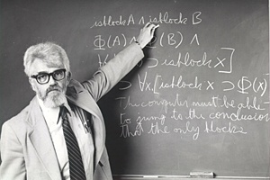
Before UNIX
1955
John McCarthy presents the origin of the concept of time-sharing
His idea had a effect on developing the CTSS.
John McCarthy (born September 4, 1927, in Boston, Massachusetts),
American computer scientist and cognitive scientist
received the Turing Award in 1971 for his major AI contributions.
inventor of the Lisp programming language.
The US government passed a degree imposing a restraint of trade against AT&T.
The company was not permitted to make money from non-telecommunications business.
1962
MIT's Computation Center developed first time-sharing operating systems called the CTSS(Compatible Time-Sharing System)
The CTSS gave inspiration to the development of MULTICS(MULTiplexed Information and Computing Service).

Slide 4
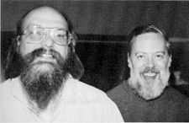
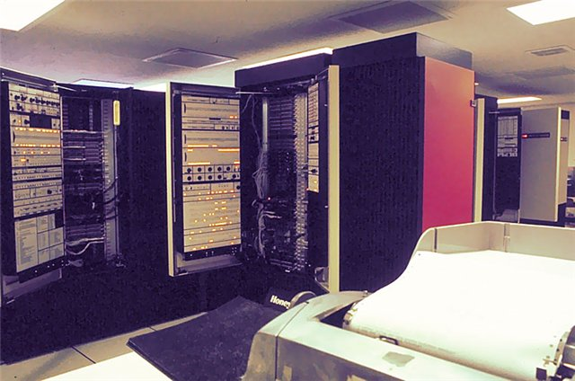
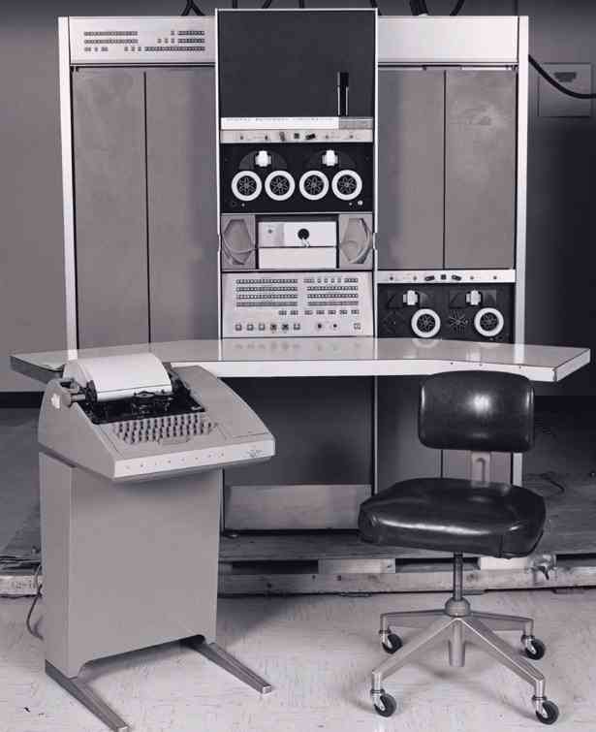
History (1/12)
1969 - 1971
Researchers from GE, MIT and Bell Labs launch an ambitious OS for mainframes, called MULTICS.
It designed to run on the GE-645
But, It failed.
Ken Thompson continued to develop for the GE-645 mainframe and wrote a game for that computer called Space Travel.^{[1]}
However, he found that the game was too slow on the GE machine and was expensive.
He found a little-used PDP-7 at Bell Labs that fit the bill.
GE-645
PDP-7

Slide 5
History (2/12)
On this PDP7, a team of Bell Labs researchers led by Thompson and Ritchie, including Rudd Canaday, developed
a hierarchical file system, the notions of computer processes and device files, a command-line interpreter, and some small utility programs.
Brian Kernighan joined the project name UNICS(Uniplexed Information and Computing Service) as a play on MULTICS.
For the first time in 1970, the Unix operating system was officially named and ran on the PDP-11/20.
The first version of UNIX was written in assembler language.
AT&T made UNIX available to universities and commercial firms, as well as the United States government under licenses.
The licenses included all source code including the machine-dependent parts of the kernel, which were written in PDP-11 assembly code.

Slide 6
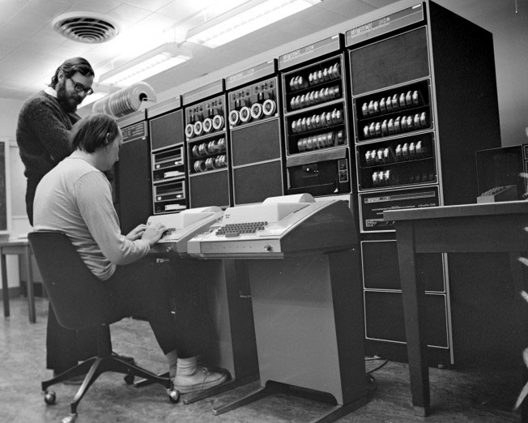
History (3/12)
1973
Ken Thompson wrote a very simple language he called B, which he got going on the PDP-7. It worked, but there were problems.
Dennis Ritchie had written the first C compiler
Ken Thompson teamed up with him to rewrite the UNIX kernel in C
It was easier to modify Unix to work on other machines (thus becoming portable), and other developers could create variations
Dennis Ritchie (standing) and Ken Thompson begin porting UNIX to the PDP-11 via two Teletype 33 terminals.

Slide 7
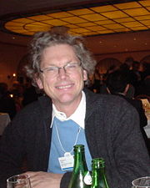
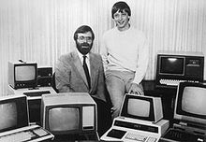
History (4/12)
1974
UNIX published in Communications of the ACM by Thompson and Ritchie.
1977
Split in the development of UNIX
UC-Berkeley released its own version, the Berkeley Software Distribution (BSD – Bill Joy)
they developed a lot of utilities such as vi, shell, and curses.
1980
Microsoft entered the OS business with its own version of Unix, called Xenix.
1981
IBM gave Microsoft a contract to develop the OS for the new line of PCs

Slide 8
History (5/12)
1982
AT&T now licensed UNIX System III, based largely on Version 7, for commercial use, the first version launching
Bill joy(BSD) went on to co-found Sun Microsystems and created SunOS(now Solaris) – with Andreas Bechtolsheim and Vinod Khosla
They developed Unix-based Workstations.
1983
4.2BSD: First release of TCP/IP and socket API.
the U.S. Department of Justice settled its second antitrust case against AT&T and broke up the Bell System.
AT&T promptly rushed to commercialize Unix System V.
Thompson and Ritchie jointly received the Turing Award for their development of generic operating systems theory and specifically for the implementation of the UNIX operating system.

Slide 9
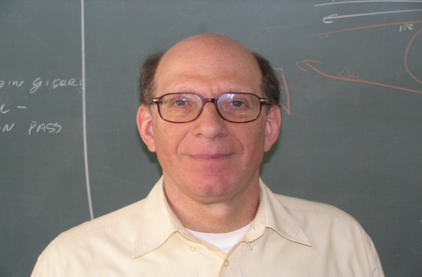
History (6/12)
1984
X/Open consortium was established.
Their goal was to create an open system specification based on UNIX.
1985
Professor Andrew Tanenbaum wrote a Unix like operating system called MINIX for i386 for Intel PC
MINIX also inspired the creation of the Linux kernel.
1987
AT&T and Sun Microsystems started
merged features from Xenix, BSD, SunOS, and System V into System V Release 4 (SVR4) independently of X/Open

Slide 10
History (7/10)
1988
Open Software Foundation released OSF/1, their standard Unix implementation, based on Mach and BSD
The same year, AT&T and another group of licensees responded by forming UNIX International.
X/Open took a neutral attitude.
IEEE's POSIX specification (IEEE Std 1003.1-1988 ) was published.

Slide 11
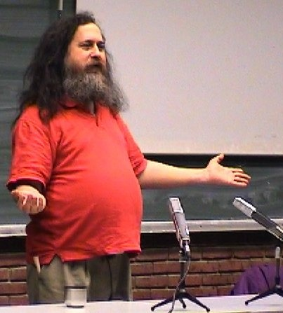
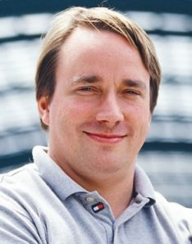

History (8/12)
1991
Linus Torvald released Linux on the Internet as an Open Source product.
The FSF(Free Software Foundation), started by Richard Stallman, naturally adopted the Linux kernel to complete the GNU system.

Slide 12
History (9/12)
1993
major participants in UI and OSF formed the Common Open Software Environment (COSE) alliance,
In June, AT&T sold its UNIX assets to Novell
Novell decided to transfer the UNIX® trademark and certification rights to the X/Open Consortium.
Novell tried to use this to battle against Windows NT, but their core markets suffered considerably.
1994
UI and OSF merged, and the combined entity retained the OSF name.
X/Open published Spec1170 based on System V
1995
The business of administering and supporting the existing UNIX licenses, plus rights to further develop the System V code base, were sold by Novell to the Santa Cruz Operation(SCO).

Slide 13
History (10/12)
1996
X/Open and the new OSF merged to form the Open Group.
1997
Open Group released the Single UNIX Specification Version 2
1998
Open Group and IEEE started the Austin Group
Austin Group began to develop the combined standard of POSIX and the Single UNIX Specification
2000
SCO sold its entire UNIX business and assets to Caldera Systems

Slide 14
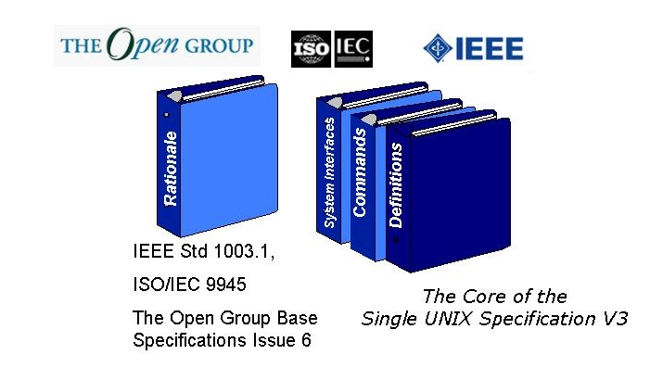
History (11/12)
2001
Austin Group released Single UNIX Specification Version3
The Open Group Base Specifications Issue 6
IEEE Std 1003.1-2001(POSIX.1)
ISO/IEC 9945:2002 (they are the same document!)
http://www.unix.org/
Compliance
AIX, HP/UX, Mac OS X, SCO, Solaris, Tru64 UNIX, z/OS …

Slide 15
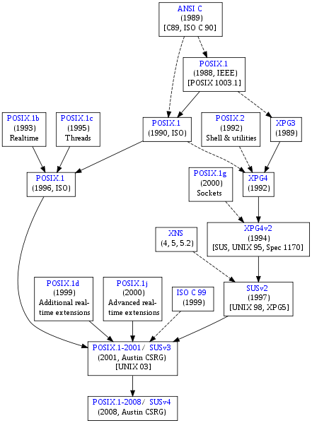
History (12/12)
2008
In December 2008, the Austin Group published a new major revision, known as POSIX:2008 (formally: IEEE Std 1003.1-2008). This is the core of the Single UNIX Specification, Version 4

Slide 16
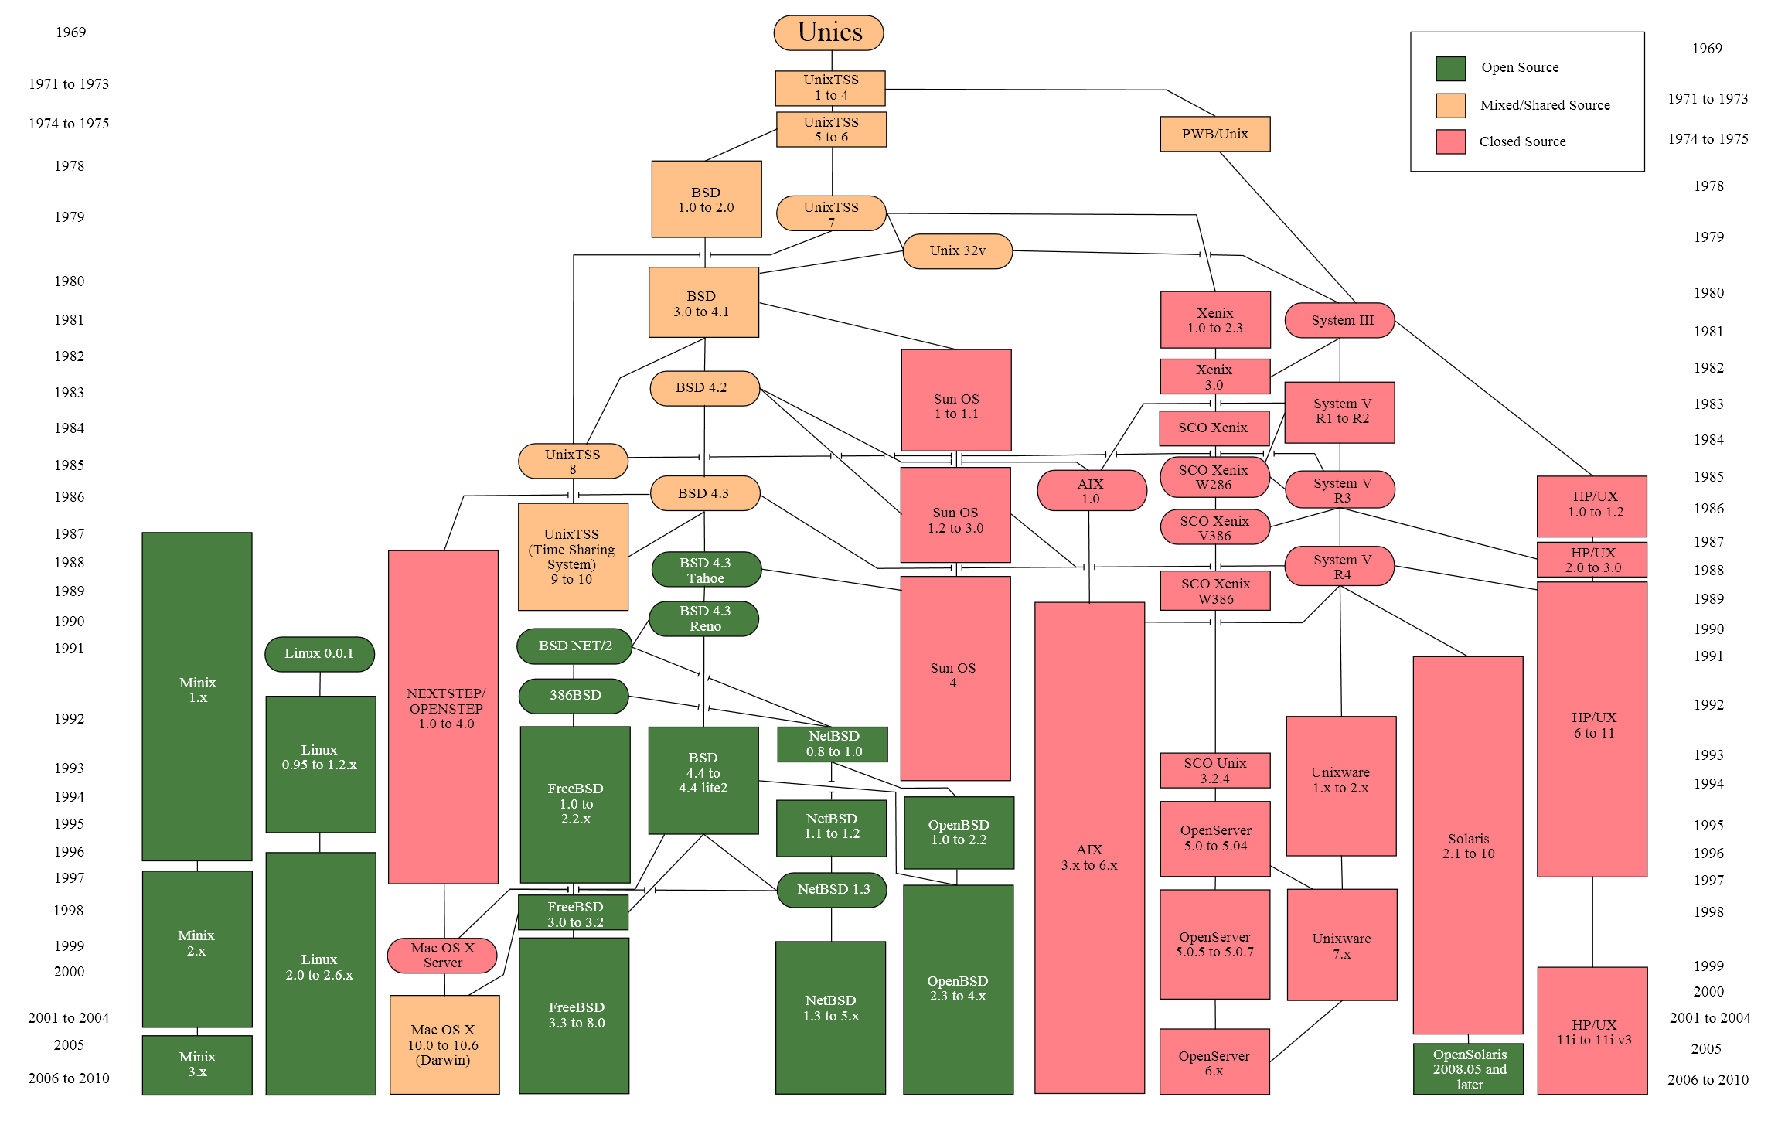
Evolution of Unix and Unix-like systems

Slide 17
Major Types of Unix
Name of Unix
AIX BSD/OS HP-UX Irix MachTen Nextstep OSF/1 SCO Unix Sloaris SnnOS Ultrix Unixware FreeBSD Linux NetBSD
Company
IBM Berkeley Software Software Design (BSDI) Hewlett-Packard (HP) Silicon Graphic Tenon Intersystems Next Digital Equipment Corporation (DEC) Santa Cruz Operation (SCO) Sun Microsystems Sun Microsystems Digital Equipment Corporation (DEC) Novell
FREE

Slide 18
Assignment !!
Install Freeware UNIX
Solaris(http://www.sunfreeware.com)
BSD
http://www.freebsd.org/
http://www.openbsd.org/
http://www.netbsd.org
Linux
http://distrowatch.com/ : Linux-ranking site
http://cygwin.com
http://www.ubuntu.com/
http://fedoraproject.org/
http://www.opensuse.org/

Slide 19
Virtual System
Commercial Software
http://vmware.com/
Open Source Software
http://www.virtualbox.org/

Slide 20
Appendix
Standard Issue

Slide 21
UNIX Standard
Name | Standard | Comments
POSIX 1988 | IEEE Std 1003.1-1988(1988L) | First Standard
POSIX 1990 | IEEE Std 1003.1-1990/ISO 9945-1:1990 | Minor update of POSIX 1988
POSIX 1993 | IEEE Std 1003.1b-1993/ISO (199309L) | POSIX 1990 + real time
POSIX 1996 | IEEE Std 1003.1-1996/ISO 9945-1:1996 (199506L) | POSIX 1993 + threads + fixes to real-time
XPG 3 | X/Open Portability Guide | First widely distributed X/Open guide
SUSV1 | Single UNIX Specification, Version 1 | POSIX 1990 + BSD + System V
SUSV2 | Single UNIX Specification, Version 2 | SUS1 update
SUSV3 | Single UNIX Specification, Version 3 (200112L) | SUS2 update
SUSV4 | Single UNIX Specification, Version 4 | SUS3 update

Slide 22
Symbols For Standard Programming (1/2)
Symbol | Value | Comments
_POSIX_SOURCE | empty | POSIX 1990
_POSIX_C_SOURCE | 1 (not to 19909L) | POSIX 1990, SUSV1
 | 2 | For C bindings with 1003.2-1992, and when _XOPEN_SOURCE is defined with no value
 | 198808L | POSIX 1988
 | 199309L | POSIX1993
 | 199506L | POSIX1996, SUSV2
 | 200112L | POSIX2001, SUSV3
 | 200809L | POSIX2008, SUSV4
_XOPEN_SOURCE | Empty | SUSV1, UNIX95
 | 500 | SUSV2, UNIX98
 | 600 | SUSV3, UNIX03
 | 700 | SUSV4
_X_OPEN_SOURCE_EXTENDED | 1 | For SUSV#

Slide 23
Symbols For Standard Programming (2/2)
#ifndef _SUVREQ_H_
#define _SUVREQ_H_
#ifdef _POSIX_SOURCE /* tmp */
#error
#endif
#if defined(SUV_POSIX1990)
#define _POSIX_SOURCE
#define _POSIX_C_SOURCE 1
#elif defined(SUV_POSIX1993)
#define _POSIX_SOURCE
#define _POSIX_C_SOURCE 199309L
#elif defined(SUV_POSIX1996)
#define _POSIX_SOURCE
#define _POSIX_C_SOURCE 199506L
#elif defined(SUV_SUS1)
#define _POSIX_SOURCE
#define _POSIX_C_SOURCE 2
#define _XOPEN_SOURCE
#define _XOPEN_SOURCE_EXTENDED 1
#elif defined(SUV_SUS2)
#define _POSIX_SOURCE
#define _POSIX_C_SOURCE 199506L
#define _XOPEN_SOURCE 500
#define _XOPEN_SOURCE_EXTENDED 1
#elif defined(SUV_SUS3)
#define _POSIX_SOURCE
#define _POSIX_C_SOURCE 200112L
#define _XOPEN_SOURCE 600
#define _XOPEN_SOURCE_EXTENDED 1
#endif
#endif /* _SUVREQ_H_ */

Slide 24
What standard does your system support?
Before writing your application following standard, you must confirm what the OS has to offer.
UNIX offers some symbols that are included unistd.h to do it.
_POSIX_VERSION :
_XOPEN_UNIX :
_XOPEN_VERSION :3(XPG3), 4(SUSV1)

Slide 25
#define SUV_SUS3
#if 1
#include "suvreq.h"
#endif
#include <unistd.h>
#include <stdio.h>
int main(void){
printf("Request:\n");
#ifdef _POSIX_SOURCE
printf("\t_POSIX_SOURCE defined\n");
printf("\t_POSIX_C_SOURCE = %ld\n", (long)_POSIX_C_SOURCE);
#else
printf("\t_POSIX_SOURCE undefined\n");
#endif
#ifdef _XOPEN_SOURCE
#if _XOPEN_SOURCE == 0
printf("\t_XOPEN_SOURCE defined (0 or no value)\n");
#else
printf("\t_XOPEN_SOURCE = %d\n", _XOPEN_SOURCE);
#endif
#else
printf("\t_XOPEN_SOURCE undefined\n");
#endif

Slide 26
#ifdef _XOPEN_SOURCE_EXTENDED
printf("\t_XOPEN_SOURCE_EXTENDED defined\n");
#else
printf("\t_XOPEN_SOURCE_EXTENDED undefined\n");
#endif
printf("Claims:\n");
#ifdef _POSIX_VERSION
printf("\t_POSIX_VERSION = %ld\n", (long)_POSIX_VERSION);
#else
printf("\tNot POSIX\n");
#endif
#ifdef _XOPEN_UNIX
printf("\tX/Open\n");
#ifdef _XOPEN_VERSION
printf("\t_XOPEN_VERSION = %d\n", _XOPEN_VERSION);
#else
printf("\tError: _XOPEN_UNIX defined, but not _XOPEN_VERSION\n");
#endif
#else
printf("\tNot X/Open\n");
#endif
return 0;
}

